Slide 1
CPRG 104 Python
Networking
“Data in Motion”

Slide 2
IP Addresses & DNS
All computers on a TCP/IP network are reached using the IP address which is a logical number assigned to the device.
IP addresses are like phone numbers in that they uniquely identify devices on the network. You CANNOT have duplicates.
Most of you have a list of contacts on your phone that you use to make it easier to phone people. That is like the role of DNS on the Internet.
IP addresses will always have the form “ 204.231.4.200 “ where each section (octet) is an 8 bit number (from 0 – 255 in decimal).
The IP address 127.0.0.1 (also “localhost”) is special and refers to your own computer.

Slide 3
Ports
Continuing to follow the analogy of telephone numbers, a port is like an “extension” inside of a company.
You phone the main number for company (the IP address), then ask for the extension (the port number) to contact a particular service (like a web server) running on a computer.
It is possible to have many services running on different ports at the same time.
Each end of a network connection will use a port to identify the connection so that your computer can carry on multiple, simultaneous connections.

Slide 4
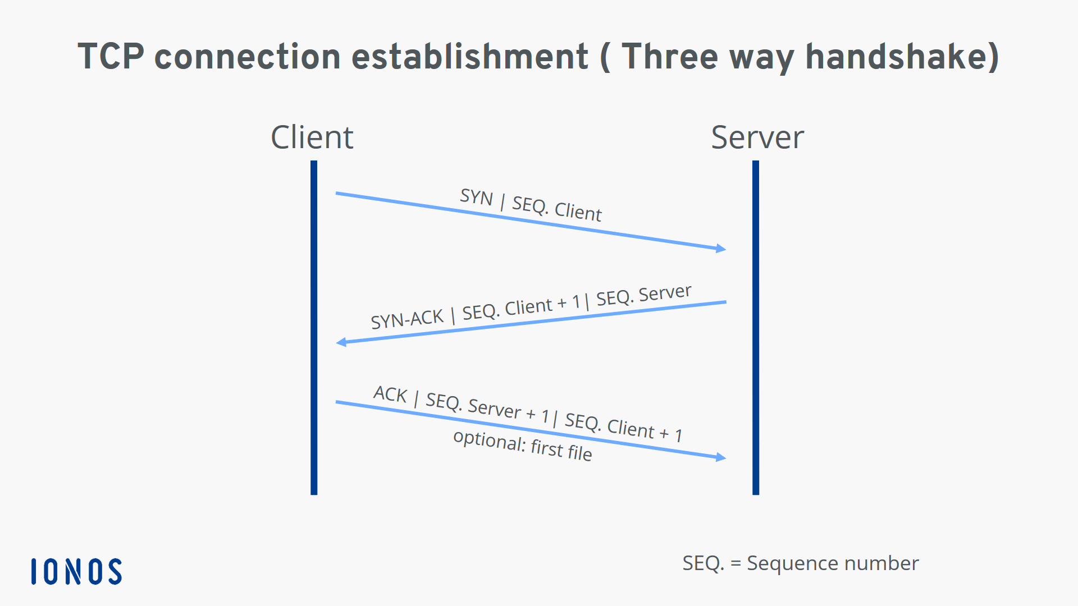
Two Delivery Options
There are two main protocols that are used for connecting computers.
The first is TCP (Transmission Control Protocol) which is like a phone call.

Slide 5
TCP Connections
All TCP connections are initiated by a “3-way handshake” to set up the connection (hence, TCP is called connection-oriented or reliable).
Steps for a TCP connection setup (3-way handshake) | Phone analogy
Synchronize (Syn) | Ringing “I want to talk to you”
Synchronize-Acknowlegment (Syn-Ack) | “Hello, I’m ready to talk”
Acknowlegment (Ack) | “Good, I’m glad you are ready to talk”

Slide 6
TCP Connections
TCP connections are “reliable” and have guaranteed delivery, meaning that traffic is acknowledged, and re-transmitted if the sending end does not receive an acknowledgement.
Just like a phone call, one end of the connection can say things like “you are speaking too quickly” or “can you repeat that”.
TCP connections are also “torn down” or ended in an orderly way.
If no TCP “keep alive” is used and no data is transmitted, the connection will stay open ... forever.
TCP “keep alive” does not need to be supported on both ends.

Slide 7
UDP
User Datagram Protocol (UDP) is more like sending a letter in the mail.
It is connection-less You have no idea if the recipient received the letter, nor if they read it.
The recipient makes no effort to acknowledge receipt of the traffic (letter).
It still makes use of an IP address / port on each end.
Often used for streaming services like streaming video or audio.

Slide 8
Sockets
The most primitive and low-level way to do networking in Python is to use sockets programming. A “socket” is a combination of IP address + port.
There are UDP and TCP server and client examples on Brightspace. These were pulled from O’Reilly Publishing’s book “Introducing Python, 2nd ed.”, but you can find the code from that book at :
https://github.com/madscheme/introducing-python/tree/master/ch17

Slide 9
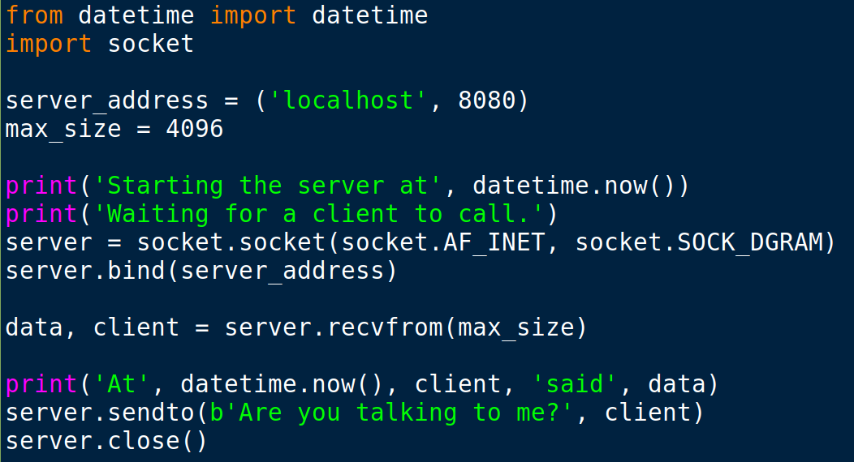
A UDP Server

Slide 10
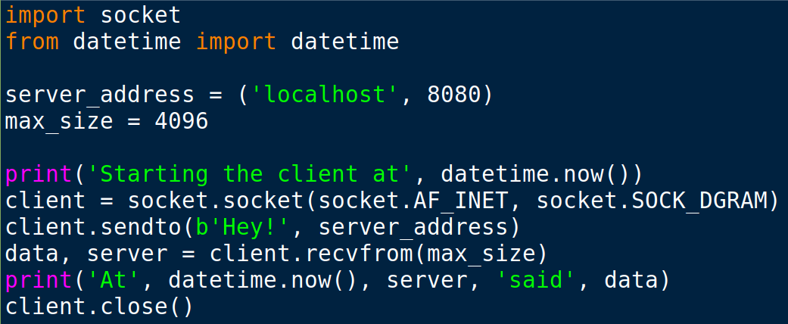
A UDP Client

Slide 11
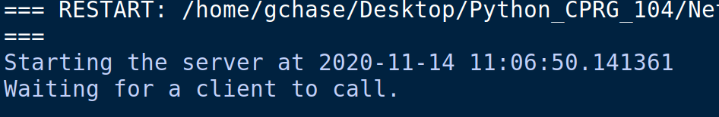
Running UDP Server
Running the server in IDLE.

Slide 12
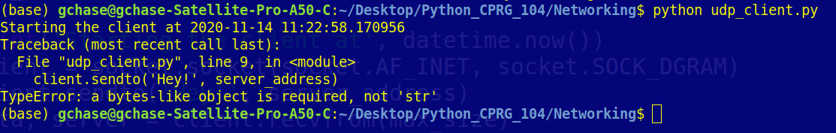
Running the Client
Running the client from a command prompt (doesn’t output properly in IDLE).
If we omit the “b” in the “client.sendto” line.

Slide 13
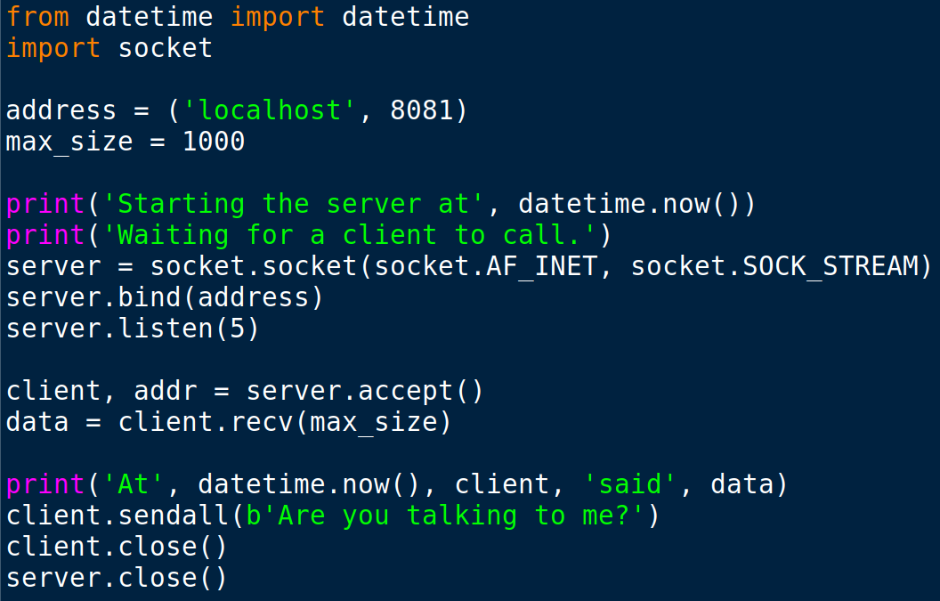
TCP Server

Slide 14
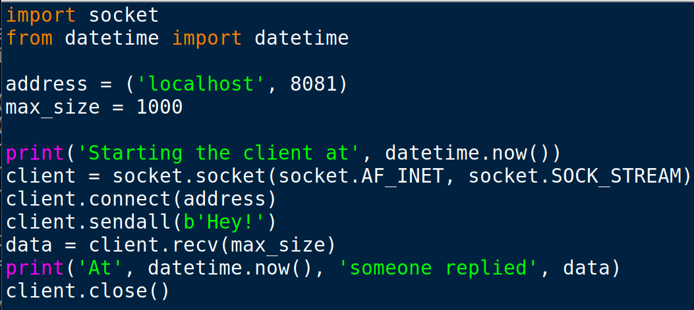
TCP Client

Slide 15
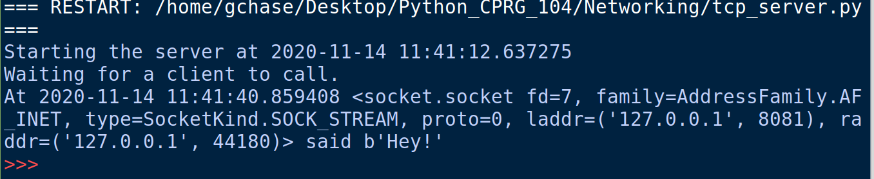
TCP Client & Server Output

Slide 16
ZeroMQ
An easier and more flexible way to create connections is using the ZeroMQ (or zmq) module.
ZeroMQ is an asynchronous (doesn’t have to wait for an answer if it sends a message), brokerless (no server ... peer to peer, unlike rabbitMQ), messaging library.
It supports a number of different types of messaging over a number of different protocols and technologies.
We will look at a couple of fairly simple examples.

Slide 17
ZeroMQ patterns
Synchronous Request / Response
Asynchronous Request / Response
Publish / Subscribe
Push / Pull
Exclusive Pair

Slide 18
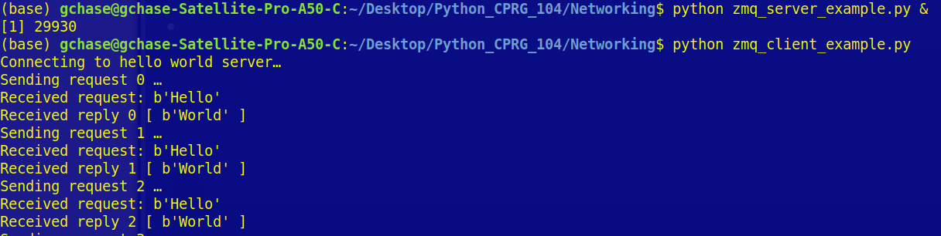
ZeroMQ
Even a simple server with ZeroMQ is more robust than pure sockets. Here I am starting the server (and sending it to the background) and then running the client. The two talk continuously until stopped.

Slide 19
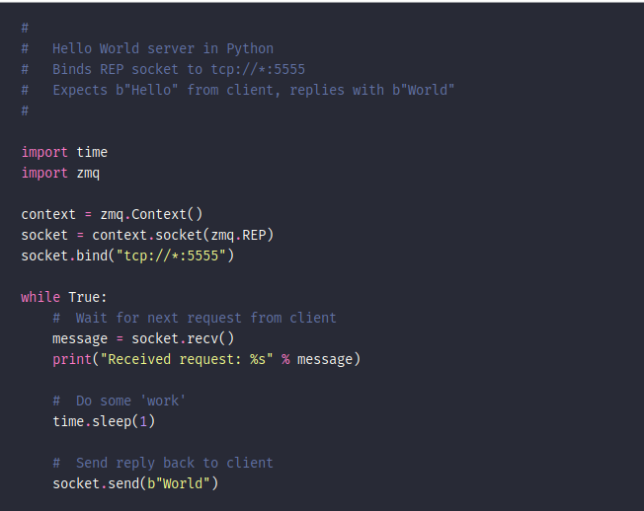
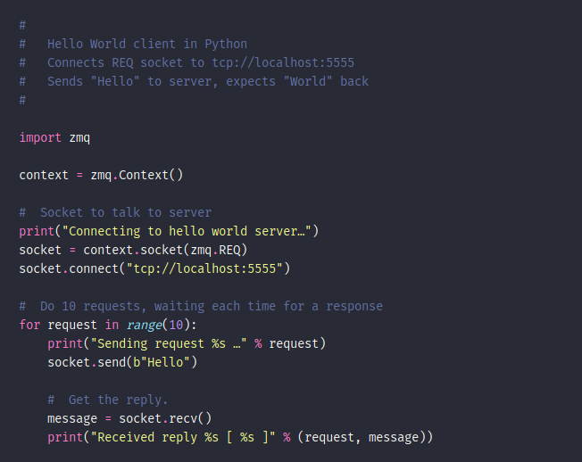
ZeroMQ

Slide 20

A Simple Streaming Video Server and Client
We can actually set up a streaming video server and client using ZeroMQ. It might not be production but it is surprisingly easy to do.
I am running both the server and the client on the same computer but there is nothing stopping you from running them on different machines. They don’t even need to be on the same network.
You will need to “python m pip install opencv-python”

Slide 21
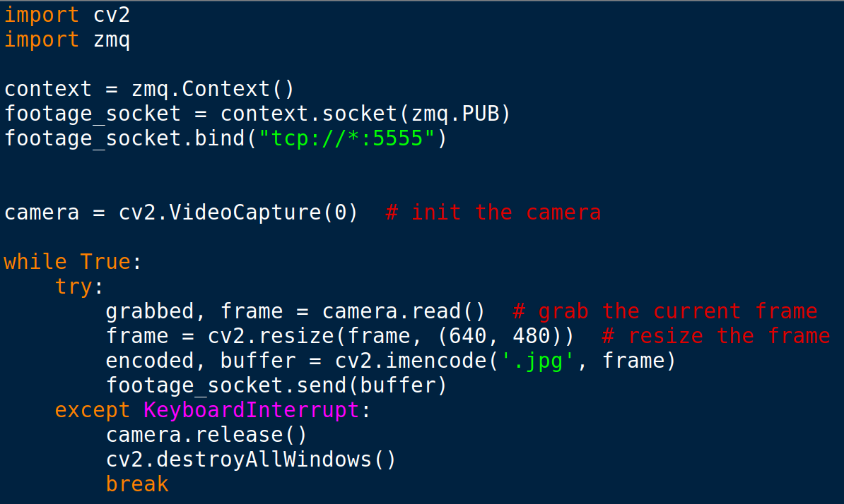
Streaming Video Server

Slide 22
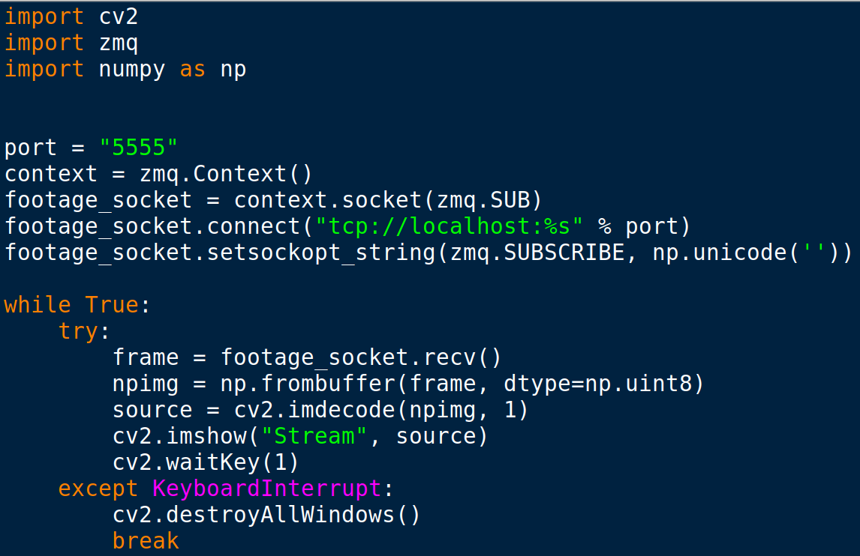
Streaming Video Client

Slide 23
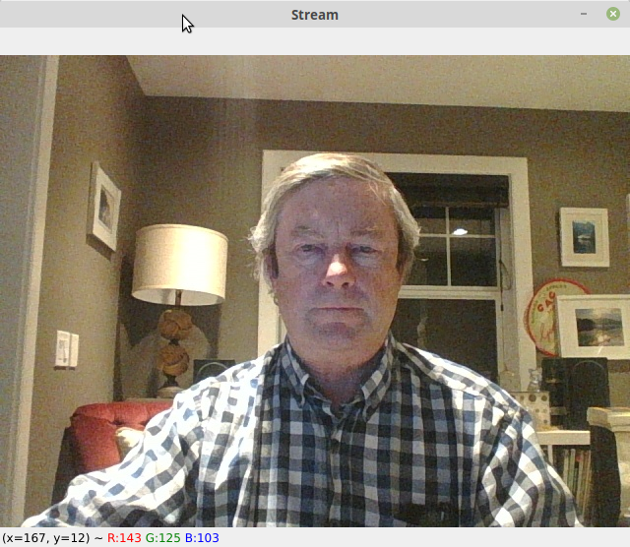
Running Server & Client

Slide 24
Sending SMS with Python
A very common task for anyone who is responsible for computer systems is to check to make sure they are running fine ... why not get your computer to send you a text if something happens ?
We can do that with Twilio. You can get a free account and phone number from Twilio (albeit with limitations).

Slide 25
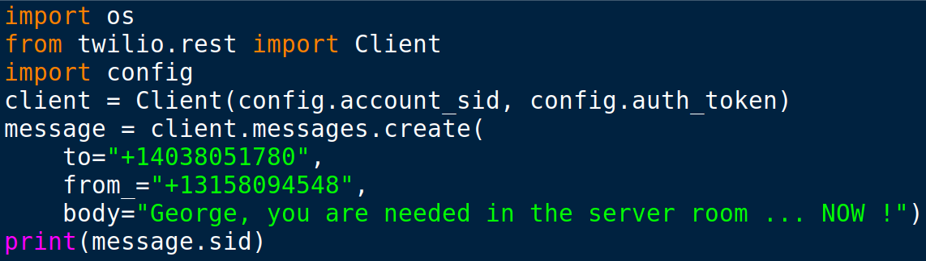
Sending SMS with Python
We have to install the twilio module with “python -m pip install twilio” before we can import it.
Obviously, in the following code example we would code it to check something before we sent a text.

Slide 26
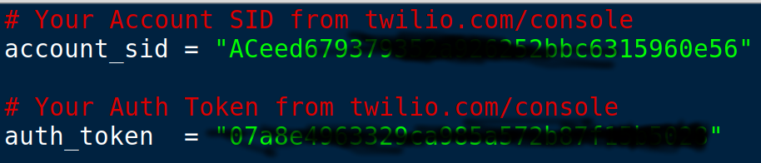
Sending SMS with Python
We can save our credentials in a separate config.py file and import it to protect our credentials or to allow others to use their own credentials.

Slide 27
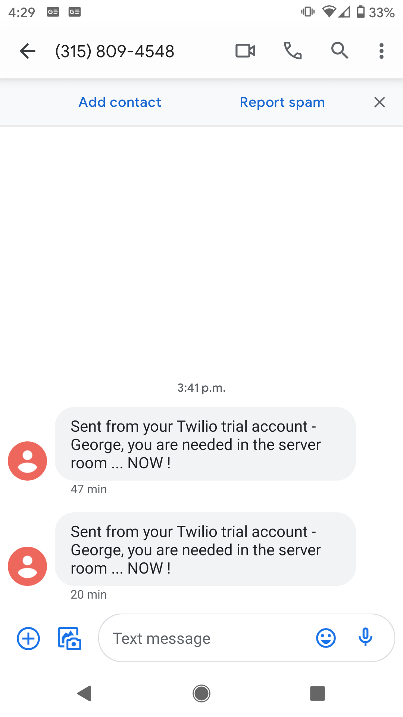
Sending SMS with Python

Slide 28
The Requests Module
A very frequent activity for Python programs is to interact with websites.
A module called Requests has been developed to both “get” webpages, submit data to web pages.
The motto of the project is “HTTP for Humans” and its purpose is to simplify interactions with web sites.

Slide 29
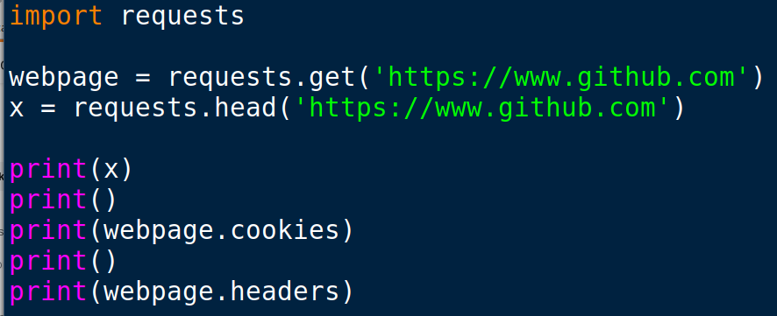
The Requests Module

Slide 30
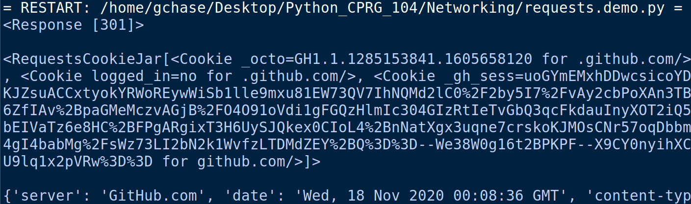
The Requests Module

Slide 31
Other Modules
Twisted – is an event-driven networking engine that supports a number of different protocols.
Beautifulsoup – is a package for parsing HTML and XML documents to extract data. Useful for web scraping.
Scrapy (NOT scapy) – another package useful for web crawling and web scraping.

Slide 32
Assignment 2
You have a choice of assignments for assignment #2
1) Make a ZeroMQ server and client (using the examples provided in Brightspace). The server should randomly select a short saying from a list or database and assign it to a variable that will be sent to the client. Use zmq_fortune.py as a starting template. If you wish to challenge yourself, do the same thing but draw your quotes from a small SQLite database that you have set up.
2) Write a simple UDP or TCP server and client in which the server will execute a specific python command if it receives a “secret” word sent from the client.
3) A variation on option #1 : Write a Python program that will text you the short saying.
4) Write a program that will contact a web site and then display the cookie information that the website gives to your browser.

